Slide 1
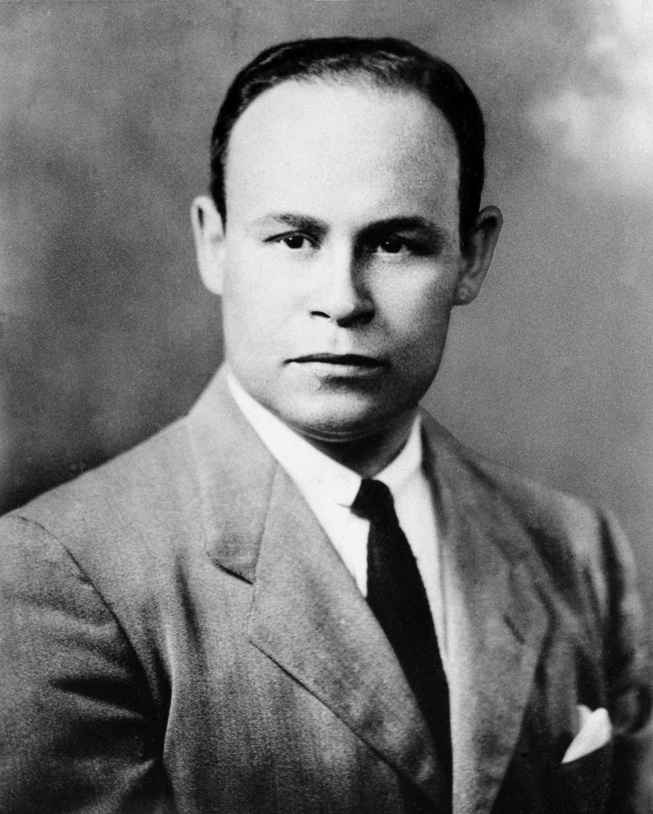

Slide 2
Greatest Achievement:
Creator of large-scale blood banks
Dr. Charles Richard Drew was born on June 3, 1904, died on April 1, 1950, was an African-American physician and researcher. He researched blood transfusions, developing better blood storage techniques, and applied his expertise in developing large-scale blood banks early in World War II.
He protested against the practice of racial segregation in donating blood from donors of different races, since there was no scientific basis.
In 1943, Drew gained distinction in his profession when he became the first African-American surgeon to serve as an examiner in the American Board of Surgery. Thanks to their work millions of lives are saved every year.

Slide 3
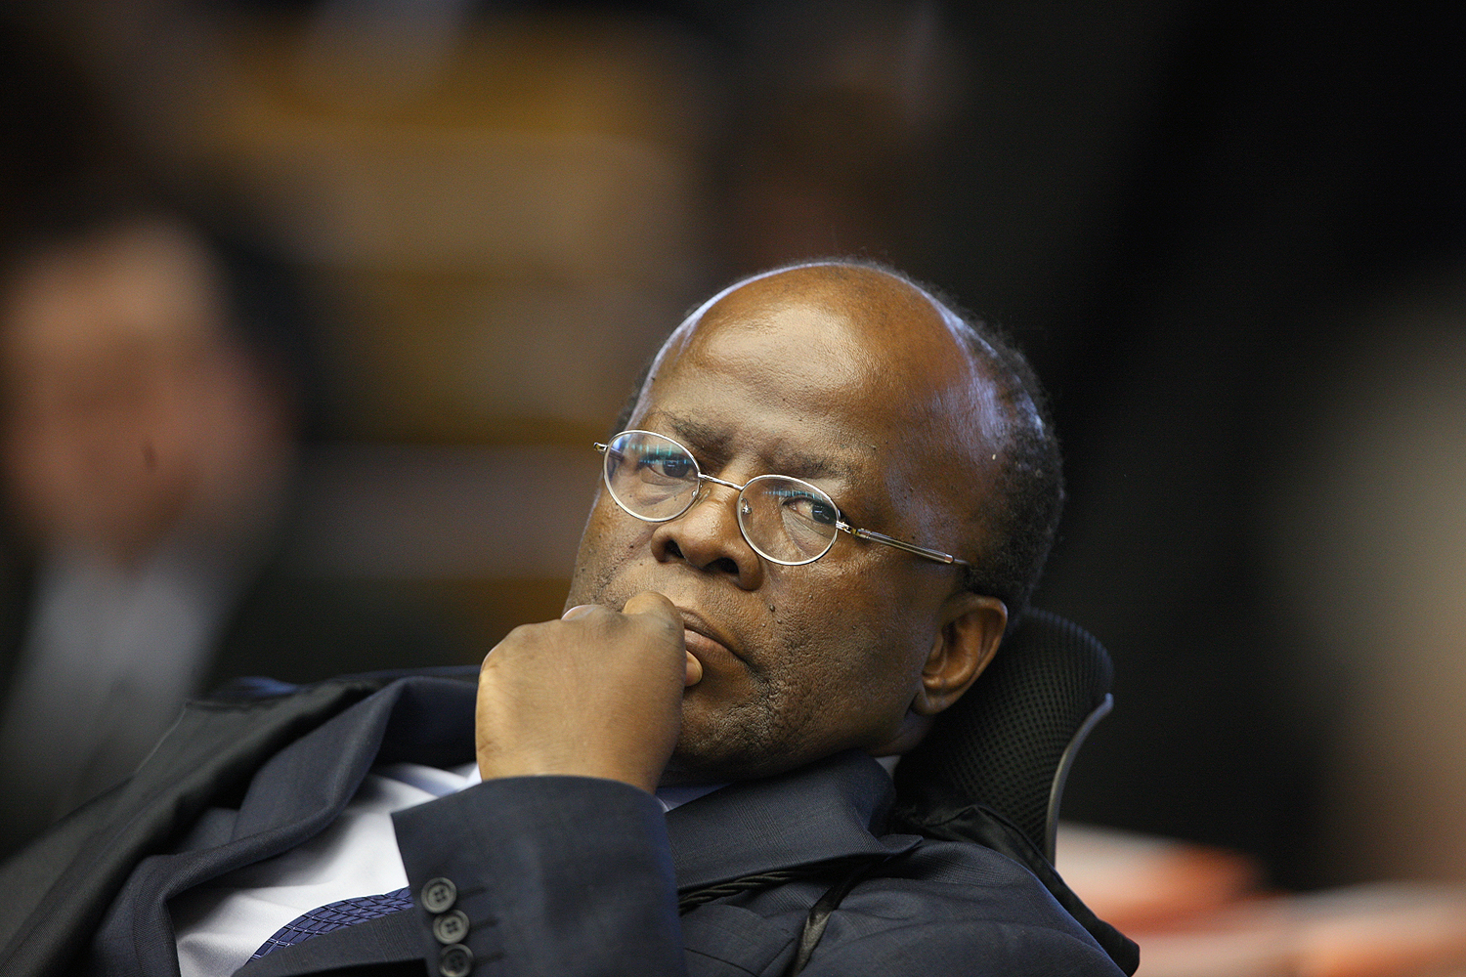

Slide 4
Greatest Achievement:
First black man to chair the STF.
Natural from Paracatu-MG, he was born on October 7, 1954.
He was born in a poor family, he went to Brasilia alone at the age of 16, where he got a job at Correio Brazilense and finished his high school in a public institution.
Bachelor of Laws from the University of Brasília, where he also obtained a master's degree in State Law. He was a Chancellery Official of the Ministry of External Relations, and later on was approved in the contest for the Republic's attorney. He also obtained a master and doctoral degree in Public Law from the University of Paris.
Indicated by President Lula as minister of the STF in 2003, he was chosen as the first black to preside over the Brazilian Federal Supreme Court.

Slide 5
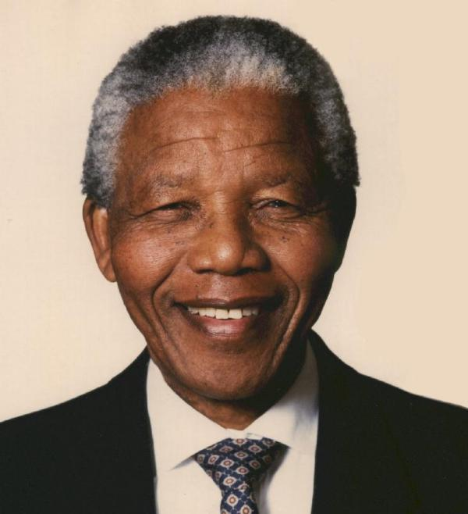

Slide 6
Greatest Achievement:
Admittedly the greatest black leader of modern history.
Nelson Rolihlahla Mandela was born in the town of Mvezo on July 18, 1918, was a lawyer, former rebel leader, and former president of South Africa from 1994 to 1999, he was considered as the most important leader of Black Africa, winning two awards; The Nobel Peace Prize in 1993, and Father of the Motherland of the modern South African nation.
He was the most powerful in the struggle against the segregationist regime of Apartheid, a racist system officialized in 1948, became a world model of resistance, being imprisoned for almost three decades for being considered a terrorist by the government of the time.

Slide 7
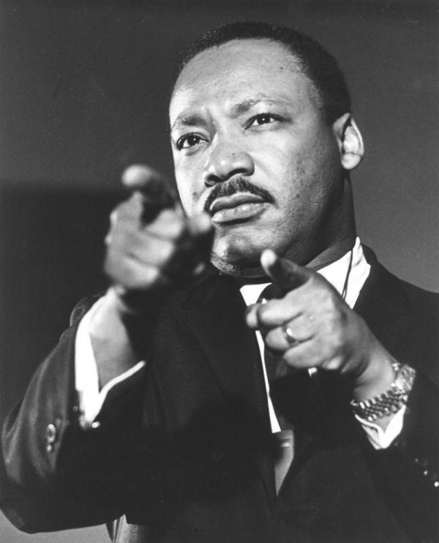

Slide 8
Greatest Achievement:
Greater advocate for the rights of black American and one of the world's largest.
Martin Luther King Jr. was born in Atlanta on January 15, 1929. Was a Protestant pastor and American political activist, he became one of the most important leaders of the black civil rights movement in the United States, and in the world, with a campaign of non-violence and love of neighbor.
He led several marches and demonstrations that culminated in his famous speech in Washington: "I Have a Dream". On October 14, 1964, King received the Nobel Peace Prize for the fight against racial inequality through nonviolence.
King was assassinated on April 4, 1968, in Memphis, Tennessee. He was posthumously awarded the Presidential Medal of Freedom in 1977 and the Congressional Gold Medal in 2004; Martin Luther King Jr. Day.

Slide 9
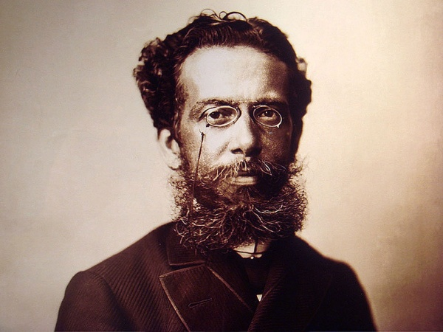

Slide 10
Greatest Achievement:
Founder of the Brazilian Academy of Letters.
Joaquim Maria Machado de Assis was born in Rio de Janeiro on June 21, 1839. He was a Brazilian writer, widely considered the greatest name in Brazilian literature. He wrote in virtually all literary genres, being a poet, novelist, chronicler, playwright, short story writer, journalist, and literary critic.
He witnessed the political change in the country when the Republic replaced the Empire and was a great commentator and reporter of the political-social events of his time. Born in Morro do Livramento, Rio de Janeiro, from a poor family, he hardly studied in schools and never attended university.
His literary influence is remarkable, both in Brazil and worldwide.

